Slide 1







How to use AOAI with your MVP benefis
Xing, Zheng

Slide 2
4 steps to use AOAI with your MVP benefits
Microsoft Account (your MVP Email)
Visual Studio subscription (your MVP Email)
Activate Azure subscription (Visual Studio subscription)
Request Azure OpenAI (Azure subscription ID)

Slide 3
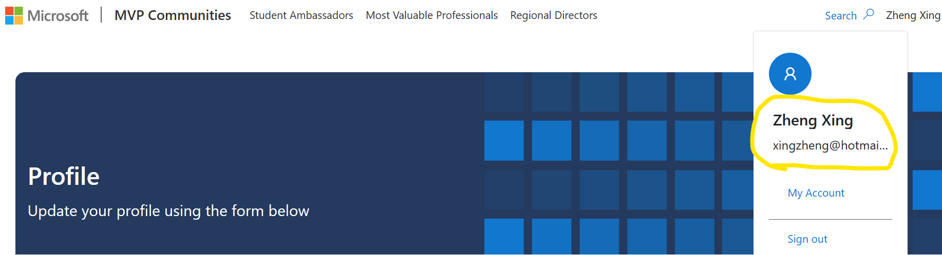
Microsoft Account
Your MS Account is the one used to claim MVP benefits.

Slide 4
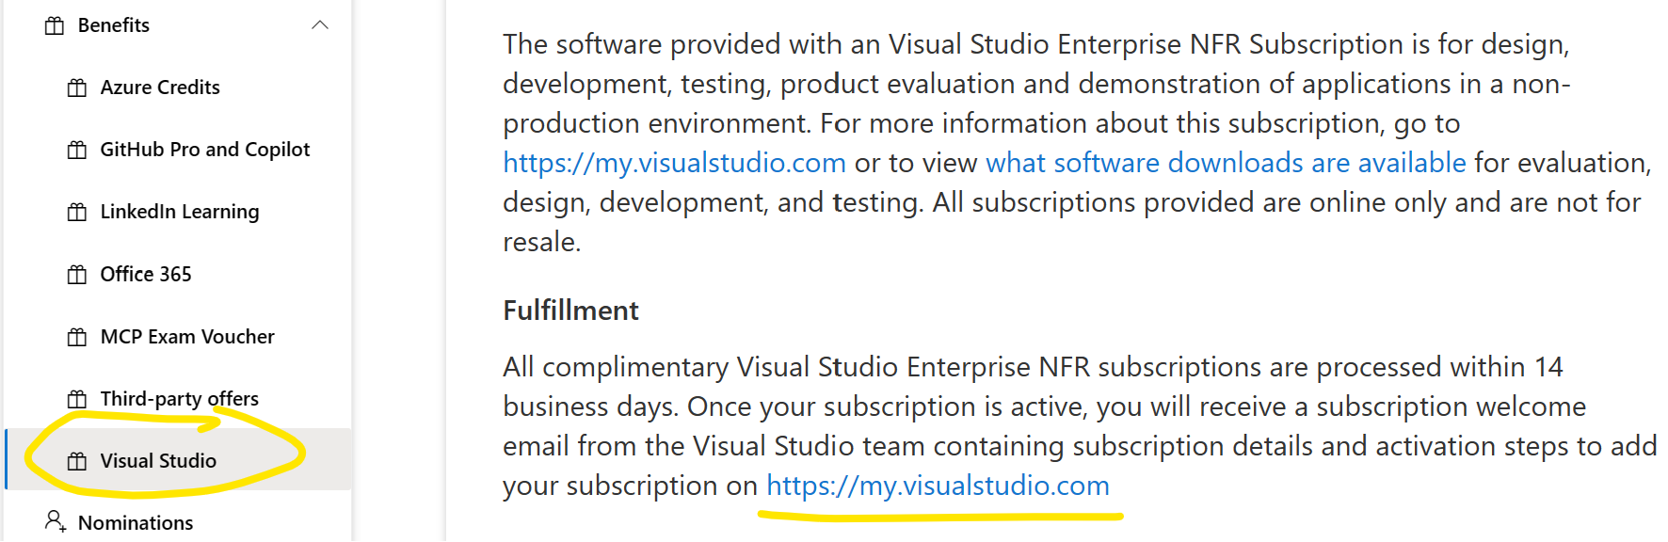
Claim Visual Studio benefits
As an awarded Microsoft MVP, you can now claim a complimentary 12-month subscription to Visual Studio Enterprise.
https://my.visualstudio.com/

Slide 5
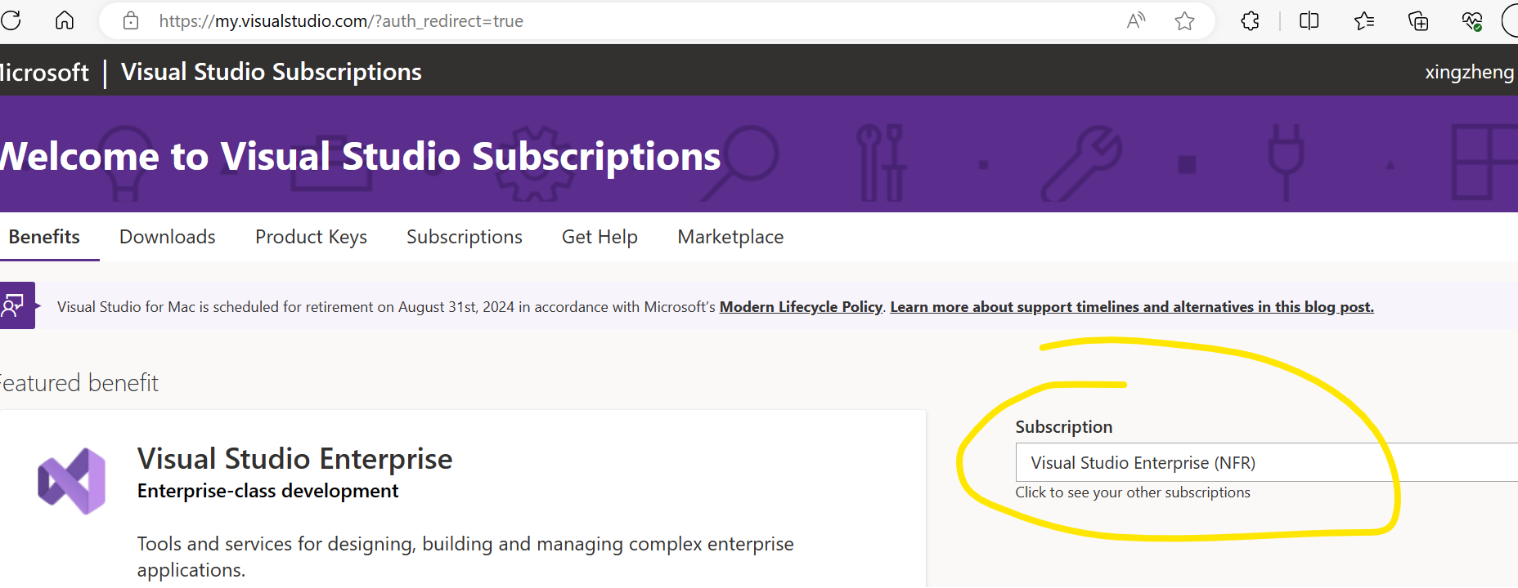
Visual Studio Subscription
Login https://myvisualstudio.com with your MS Account.
You will find your Visual Studio Enterprise subscription.

Slide 6
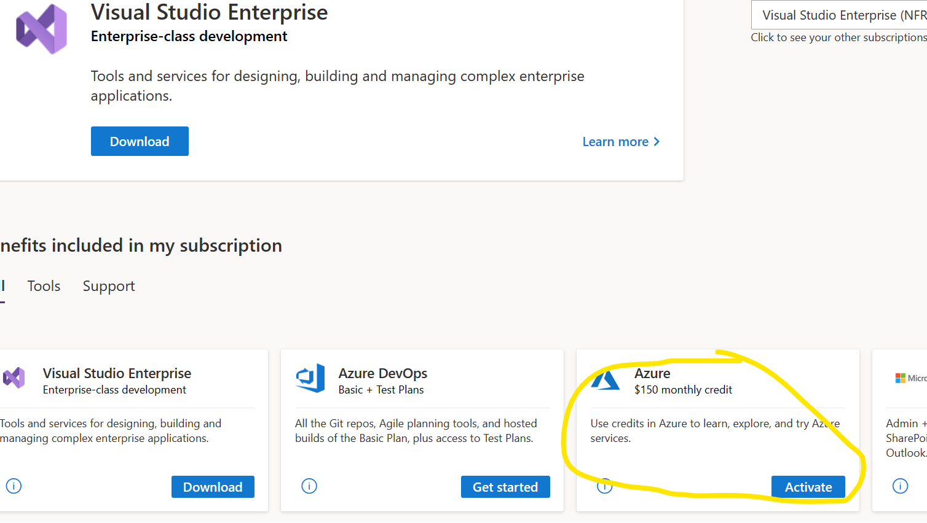
Activate Azure monthly credit
Click ‘Activate’ button to request your Azure monthly credit.

Slide 7
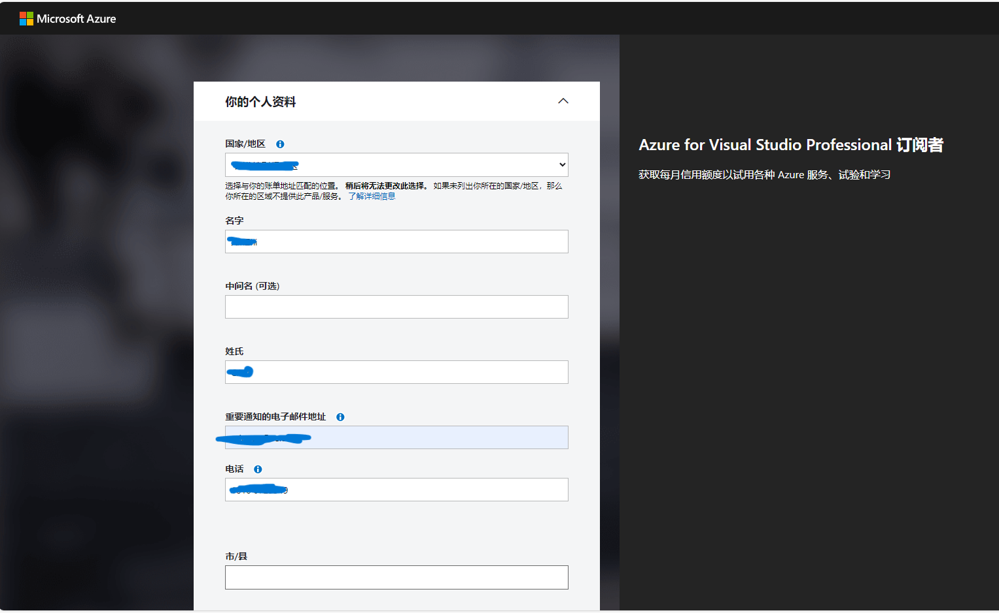
Azure for Visual Studio Subscription
Complete the application form.
Will jump to Azure Portal automatically.

Slide 8
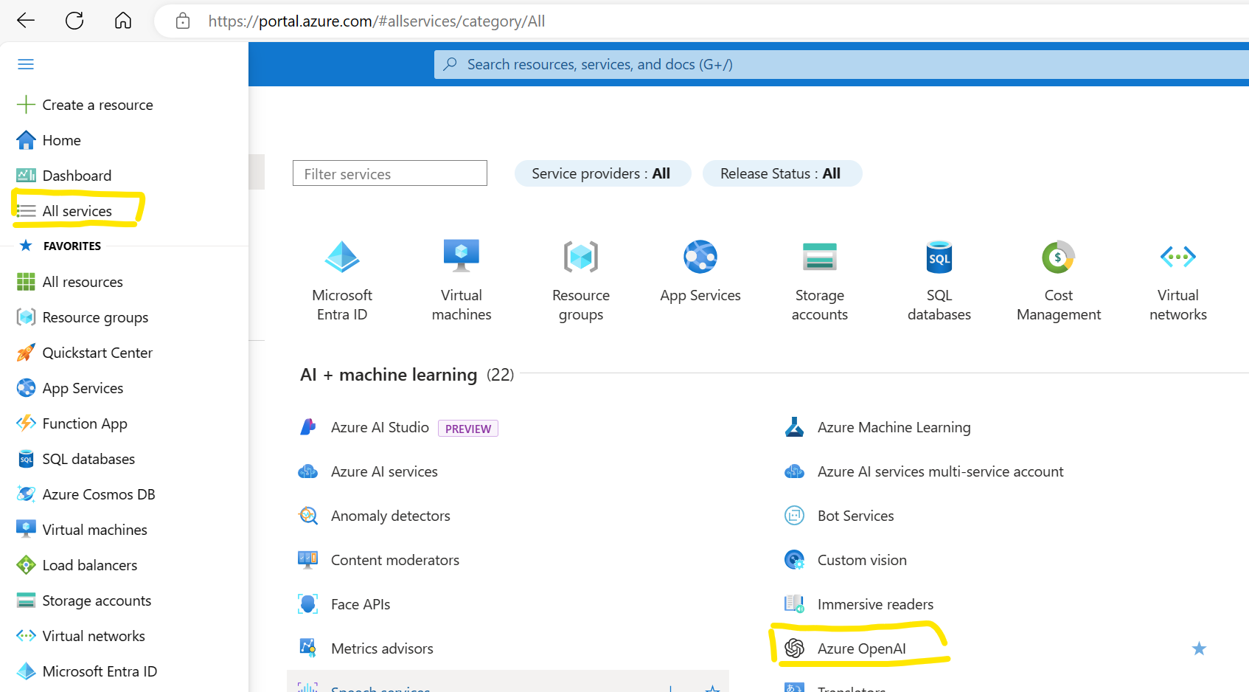
Find Azure OpenAI service
After you login Azure, click ‘All service’, and find ‘Azure OpenAI’

Slide 9
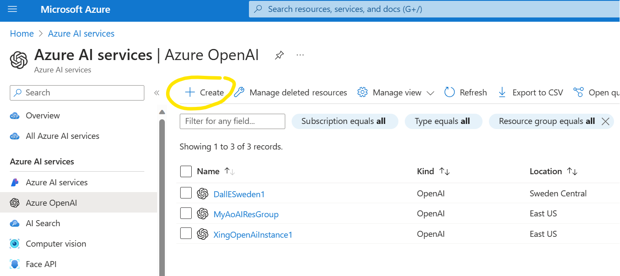
Create Azure OpenAI
Click ‘Create’ button in Azure OpenAI page.

Slide 10
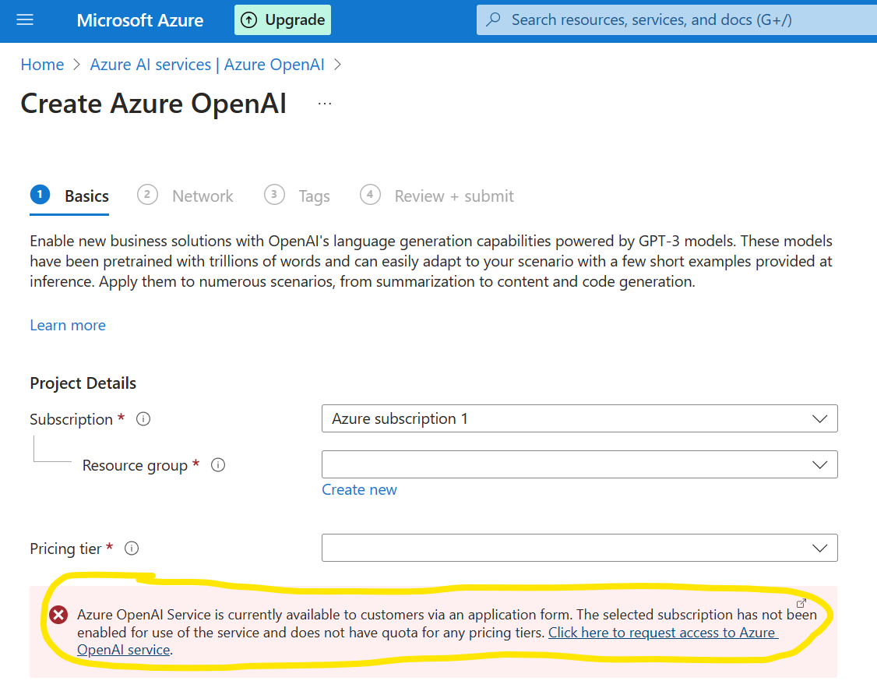
Do we forget something?
Click link to request access to Azure OpenAI service.

Slide 11
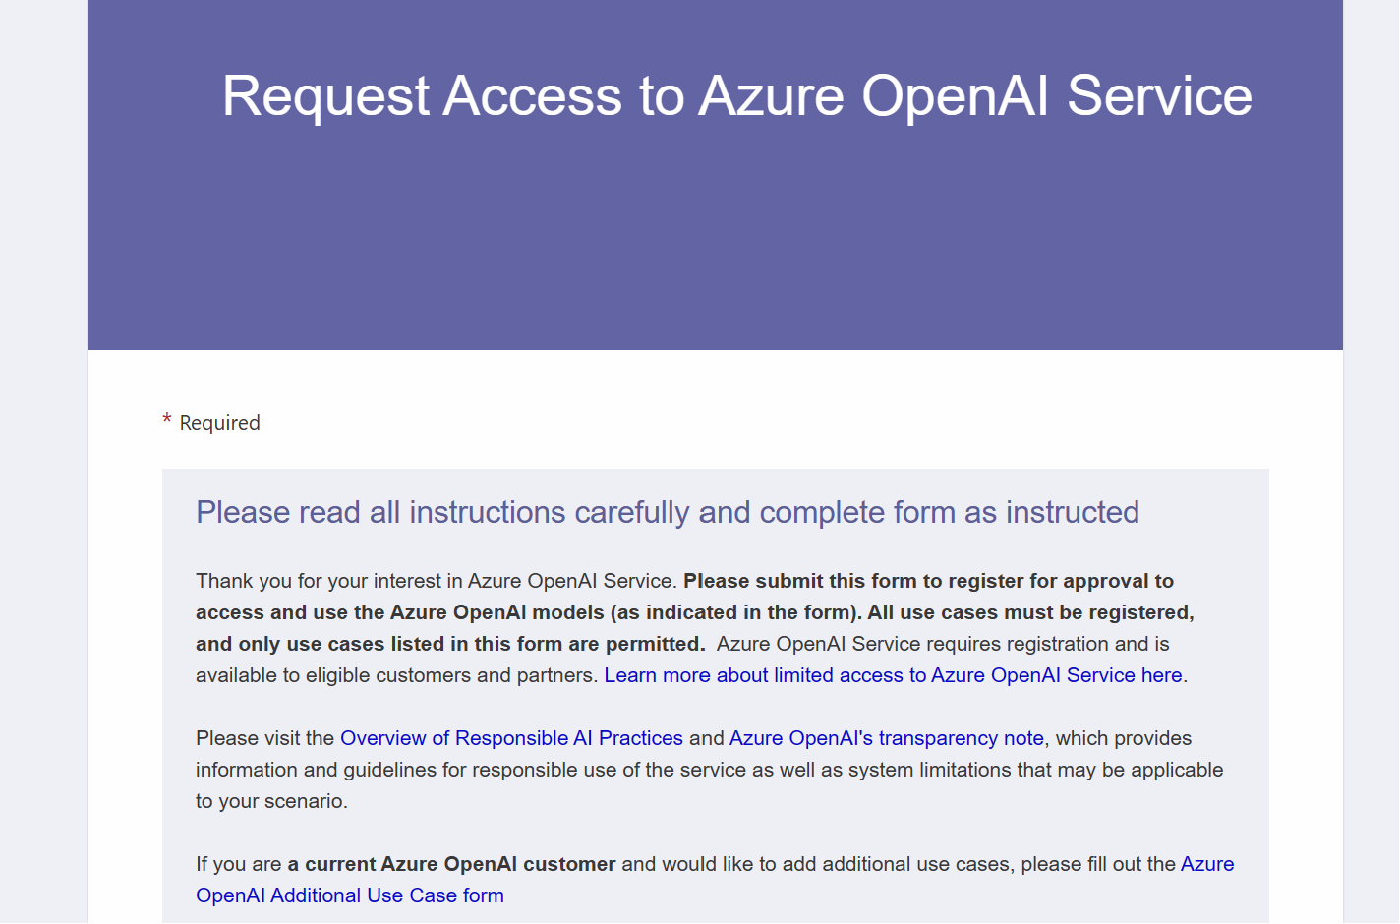
Our second application form today
https://aka.ms/oaiapply

Slide 12
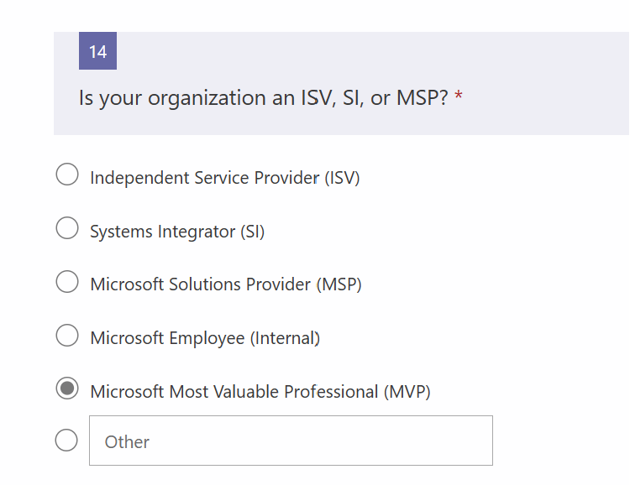
A few tips
Don’t apply with your private Email.
Suggest to use your company Email.
Proudly say that you are the MVP when answering 14 questions.

Slide 13
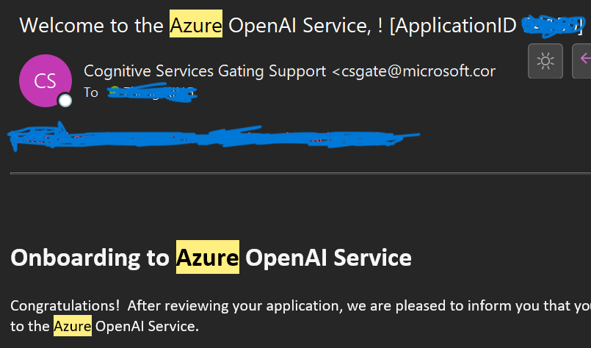
Welcome to the Azure OpenAI
Wait for an email to approve your application.

Slide 14
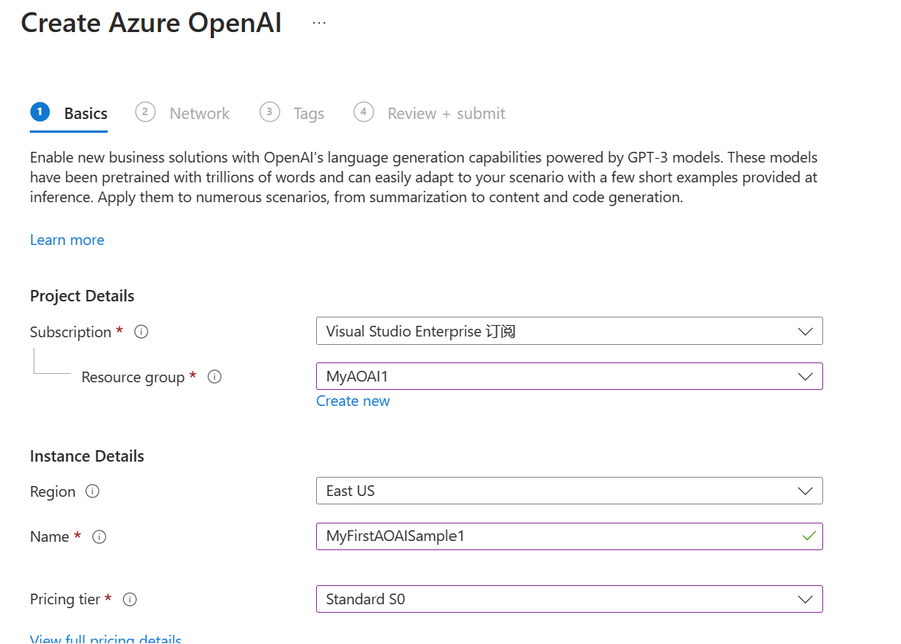
Let’s create our first AOAI instance!
Create a new Resource group.
Enter your preferred instance name

Slide 15
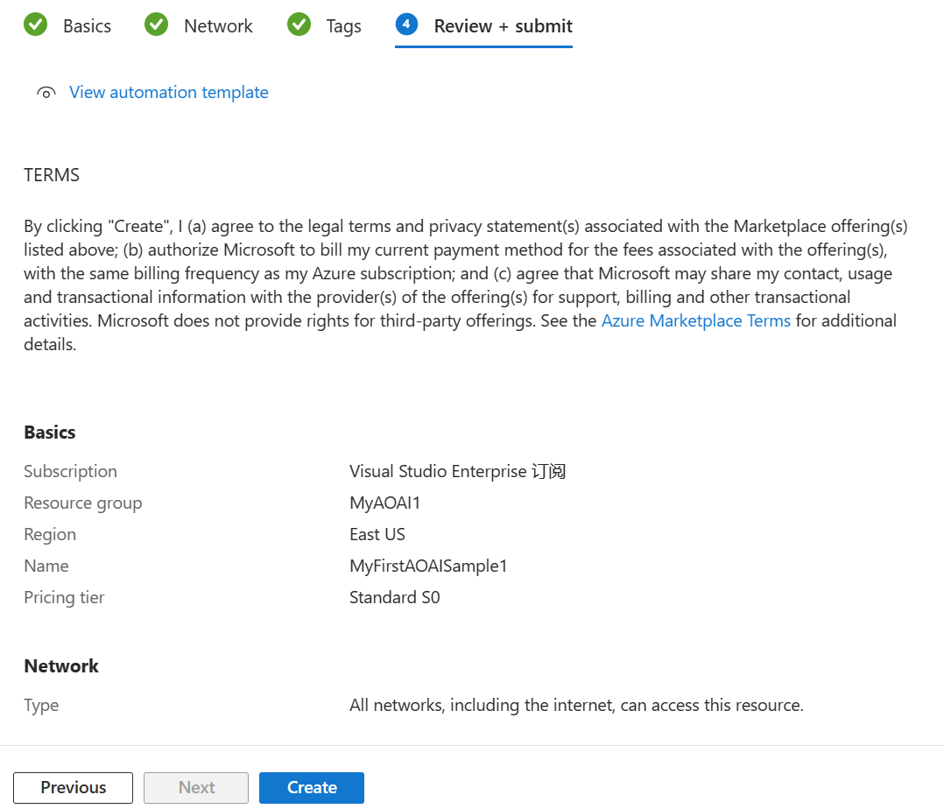
Review and submit
Next + Next + Next + Create.

Slide 16
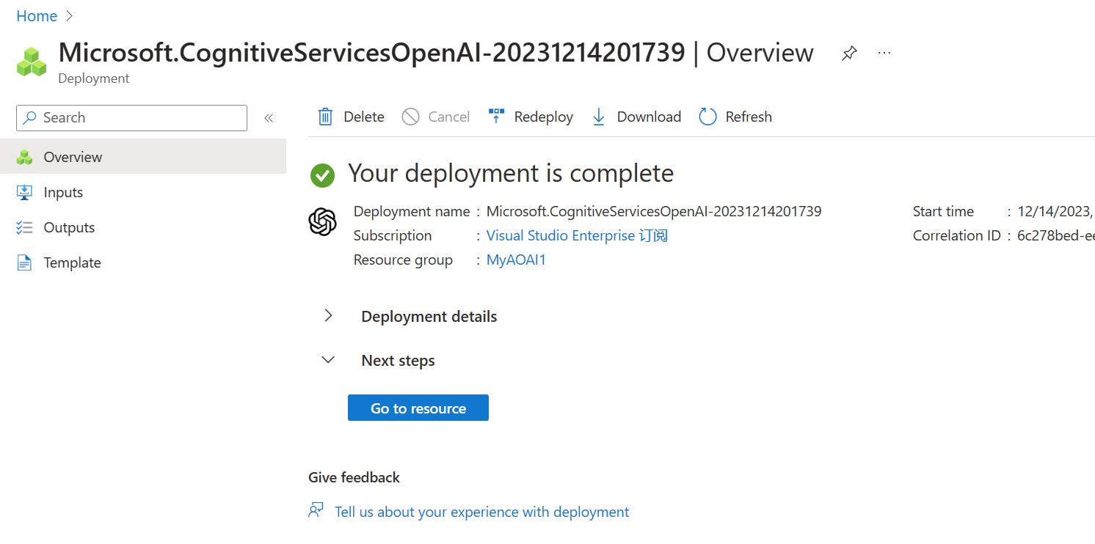



Almost there
Wait a minute.
Click ‘Go to resource’ when deployment is complete.

Slide 17
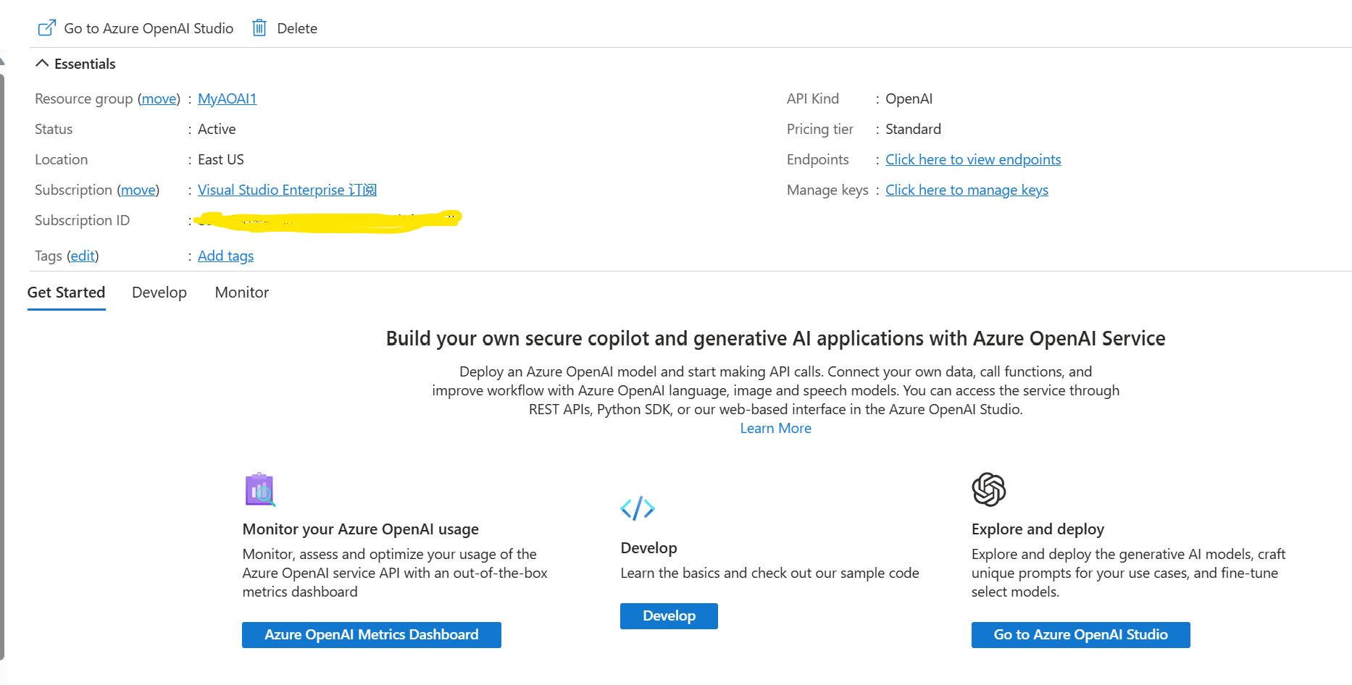
Can’t wait another minute
Click ‘Go to Azure OpenAI Studio’!

Slide 18
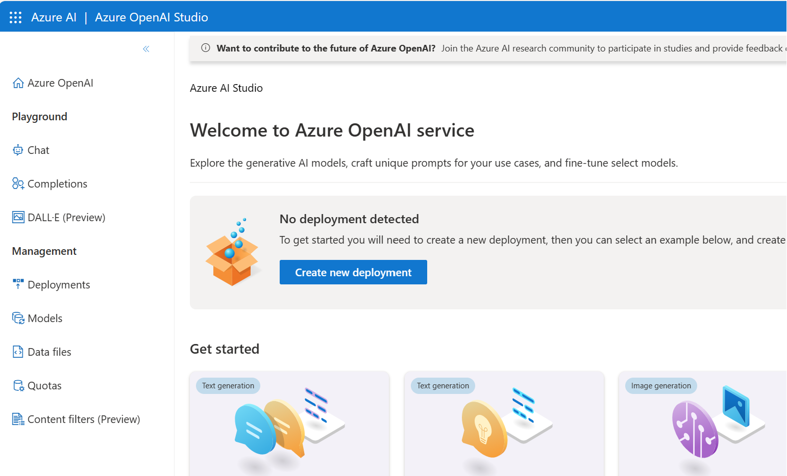
Enjoy!
Chat and DALL-E are very interesting!

Slide 19
Thank you!

